Slide 1
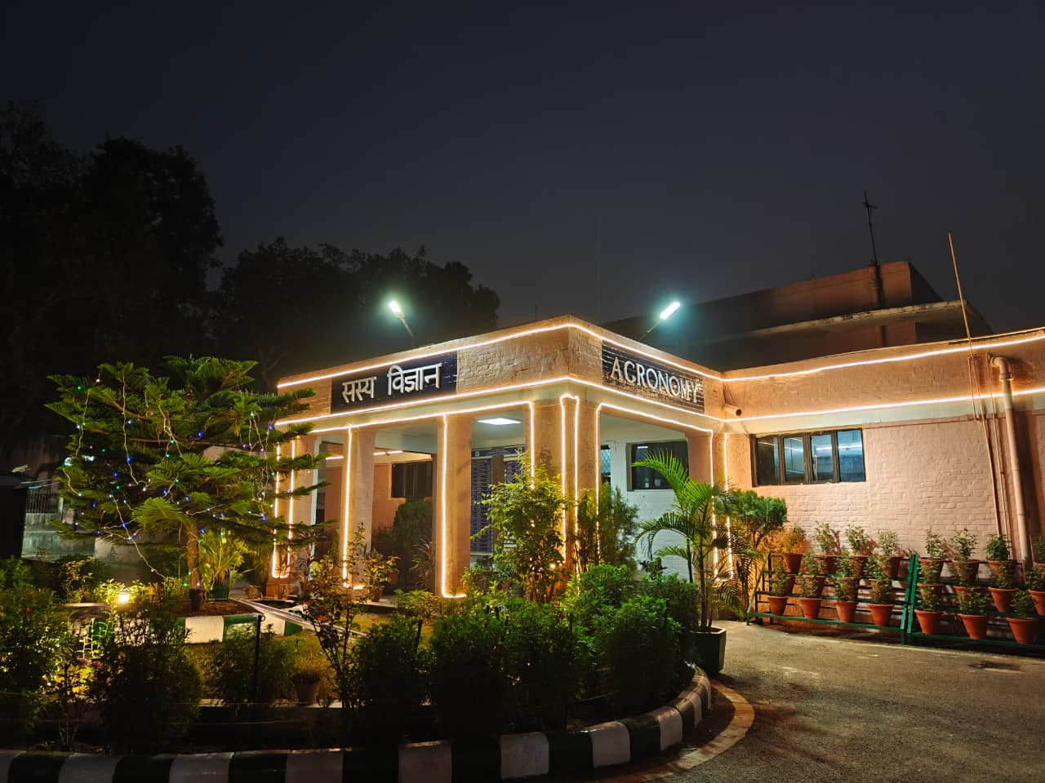
Agronomy for Viksit Bharat 2047
Dr. Sanjay Singh Rathore FNAAS
Head, Division of Agronomy
ICAR-Indian Agricultural Research Institute,
New Delhi -110 012

Slide 2
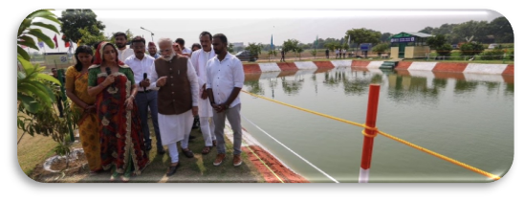
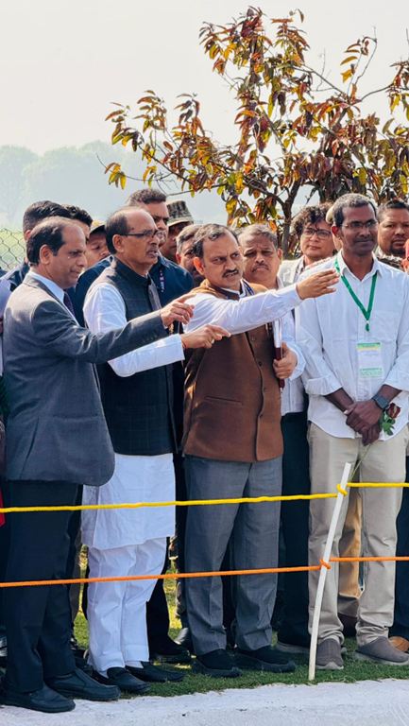
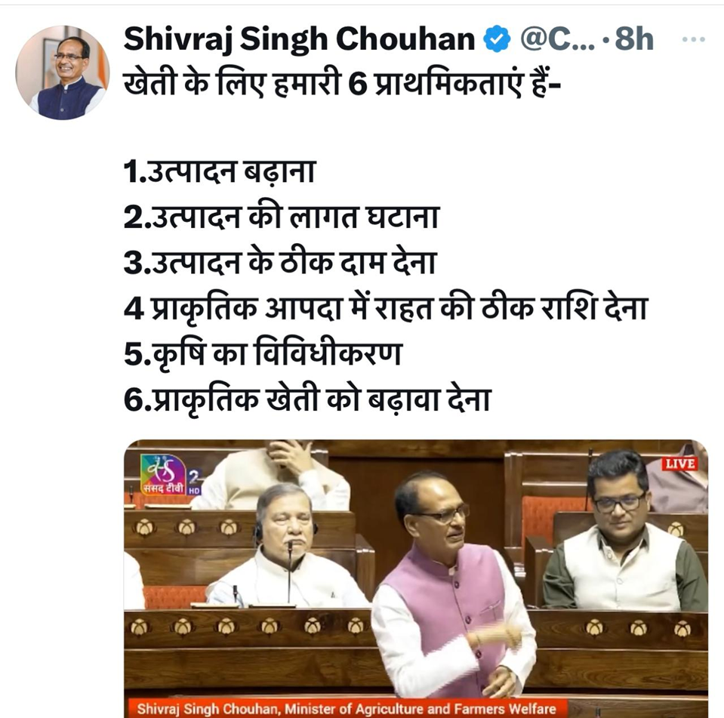
Significant Achievements of the Division during the last 5 years
Major national priority | Achievement | Impact | Targeted Area
Diversification of the existing production system Addressing malnutrition Carbon-neutral production systems Productivity and income enhancement, reducing production costs, and restoring degraded land Promotion of natural and organic farming practices | Customized IFS model (Crop + Dairy + Fishery + Poultry + Duckery + Apiary + Boundary Plantation + Biogas unit + Vermi compost) for IGP | Rice-eq. Yield 6x over R-W system Eco-efficiency index (INR per kg CO2 eq 43.9 Vs 13.2 in R-W system GHGI (kg CO₂ eq per kg food production) 0.16 Vs 0.74 in R-W system | North-western IGP (Punjab, Haryana, Delhi, U.P and Bihar)
Carbon-neutral production systems | Developed land configuration and cereal-legume integration systems for IGP | Productivity gain (11.6% over FB) (~ 2.0 Fold over maize-wheat) Eco-efficiency (~90%) Energy productivity (~2.26 times) | North-western IGP
Productivity and income enhancement, reducing production costs, and restoring degraded land | Designed ICM modules for the cereal-based system of IGP | Triple ZT maize and wheat with residues and green manures along with liquid biofertilizers / AMF and integrated water/weed/nutrient) Based on ICMs, investments gave 24.3-27.4% additional returns than conventional practices. In rice-wheat rotation, CA-based ICM modules (DSR–ZT wheat) had a positive impact on the system yields (10-14%) and farm economics (19-22%) than CT rice–wheat rotation. | North-western IGP
 | Optimisation of natural farming components for PP-wheat, PM-mustard systems and maize-wheat systems | The wheat-equivalent grain yield ranged from 36% lower in the first year to 27% higher in the third year than chemical fertilisers in the PP-wheat system. It indicates the potential NF without yield penalties over the years. | U.P., Rajasthan, H.P., Uttarakhand

Slide 3
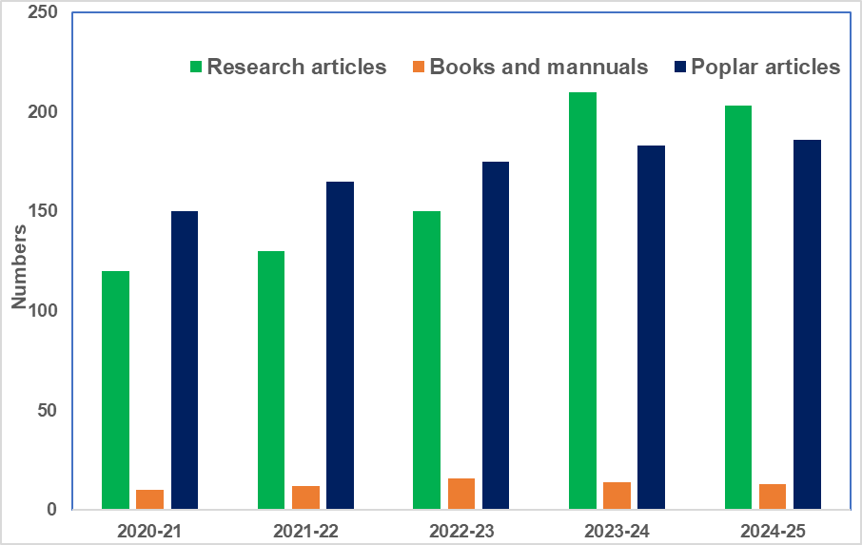
Major national priority | Achievement | Impact | Target area
Enhancing nutrients and water use efficiencies Addressing malnutrition | Development and evaluation of novel fertilizer materials | Boron-coated urea, sulfur-coated urea, and Zn-coated urea materials increased recovery efficiency (RE) up to 78% in rice crop, which is much higher than the VK@2047 target of 55%. (Targeting urea 1.5 lakh cr urea usages) | North-western IGP (Punjab, Haryana, Delhi, U.P and Bihar)
Carbon-neutral production systems | Development of an agronomic protocol for nano-fertiliser use in major cropping systems of India (Collaborative work, Agronomy, SSAC, Plant Physiology, ICAR- IARI, TNAU, GBPUAT, ICAR-CRIDA) | Overall, the use of 75% RDN through Prilled Urea (Neem-coated) and two sprays of Nano Urea gives a statistically similar yield as in 100% RDN. Further reduction in fertiliser Nitrogen to 50% and two sprays of Nano urea reduces the yield significantly. Thus, new formats of Nano urea/Nano DAP are being evaluated. | North-western IGP (Punjab, Haryana, Delhi, U.P and Bihar)
Productivity and income enhancement, reducing production costs, and restoring degraded land | Developed Sub-surface drip fertigation (SSDF) system for the maize-wheat-mung bean system | SSDF resulted in 40-50% irrigation water saving over conventional floods Nutrient savings 25-50% NPK saving NUE increased by 40-50%, KUE increased by upto 80%, PUE increased 35% in SSDF SSDF of 50% nutrients is equivalent to 100% nutrients in conventional | Indo Gangetic Plains
 | Development of an agronomic protocol for the biofortification of pearl millets, rice, and cluster bean | Agronomic biofortification resulted in Zn content in rice grain (37.9 mg kg−1) ZT (P + C – M + B) system resulted in the highest Fe content in PM grain (69.2 mg kg-1) | Rajasthan, some part of Haryana and U.P.
Total technologies certified by ICAR in the last five years: 20
Research papers: 813
Total citations of the scientists: 81152
Per scientist citation: 3528
Average H-index: 28
Externally funded Mega project: Largest CSR- project (41.0 Cr)
Pr Scientific Advisor (PSA) through Rural Technology Action Group (RuTAG) mobilises a 2.5 cr project in the division
UM6P agreed for the umbrella MOUs and proposal submitted to ICAR
Human Resource Development
AICRPs varietal evaluation

Slide 4
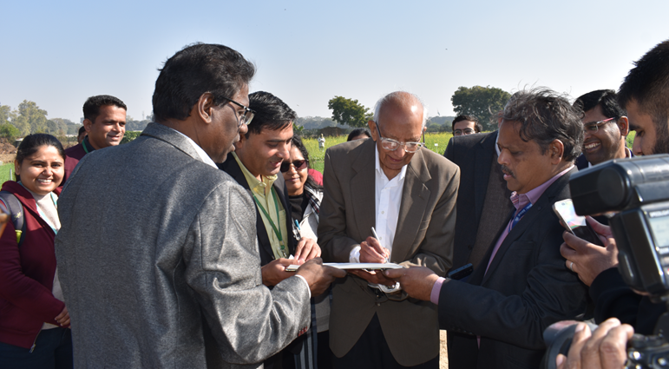
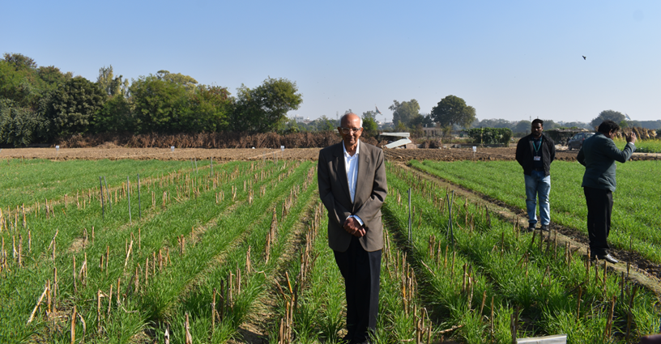
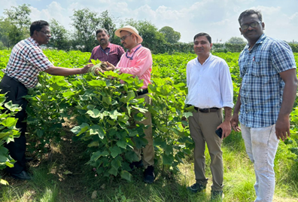
Significant Achievements of the Division during the last 5 years
National challenges/ issues addressed | Research | Outcome | Target area | Possible Benefit in target area
Decreasing crop productivity & farm income. Declining Resource-use efficiency and savings Climate change Soil health deterioration | CA based DSR-system for sustainable crop production, soil health and environment (ZT rice+ mungbean residue- ZT wheat+ rice residue-ZT mungbean+ wheat residue) | ZT + R gave lower rice yield (-3-5%) but 10-15% and 30-36% higher wheat grain yield and system productivity (SP), respectively TOC increases by 40-45% of soil 30-35% higher net returns and 2.86 B:C | North-western IGP (Punjab, Haryana, Delhi, U.P and some parts of Bihar and M.P.) | Better crop productivity Better soil health Higher livelihood security Reduces residue burning and renders environment cleaner and ecosystem services
 | CA-based maize-wheat system for higher productivity, resource use efficiency and soil health. Permanent broad bed (PBB) maize+wheat residue-PBB wheat+maize residue) | PBB+R resulted in lowest GHGI i.e., 35-37% lower than CT PBB+R+100N had 29-31% higher SP, 20-25% savings of Irri. Water and water stable aggregates of 79.2%, 72.9% and 74.8% at 0-5cm, 5-15cm and 15-30cm. 45-48% higher net returns and 40-44% higher B:C | North-western IGP (Punjab, Haryana, Delhi, U.P and some parts of Bihar and M.P.) | Better crop productivity Better soil health Higher livelihood security Provide better ecosystem services
 | CA-based cotton-wheat system for sustainable crop production, profitability and soil health Permanent broad bed (PBB) cotton+wheat residue-PBB wheat+cotton residue | Increase cotton yield by ⁓ 54%, wheat yield by ⁓22% and SP by ⁓37% than CT system Net income increased by Rs 25,000-30,000 over PTR-CTW and by 58-62% over CT system TOC increase by 95-99%, 20-22% and 25-27% at 0-5cm, 5-15cm and 15-30 cm depth of soil over CT | North-western IGP (Punjab, Haryana, Delhi, U.P and some parts of Bihar and M.P.) | Better crop productivity Better soil health potential alternative to rice-wheat system that can reduce residue burning and render environment cleaner. More C sequestration and lower GHGs emission and global warming

Slide 5
Mile stone contribution from the Division: At a Glance
CRI adds 22–34 MT wheat and can generate ₹54,000–81,000 crore revenue.
Neem-Coated Urea saves 5 kg/bag, cuts N losses by ~7 kg/ha, reduces imports by 7 MT, saves ₹6,000–7,000 crore subsidy, and increases NUE by 10–15%.
IFS gives 2–6× more food, 2–3× higher income, 60–70% eco-efficiency, and 3–4× energy productivity; by covering 10% area in the rice-wheat belt, it can yield ~ ₹13,231 crore benefit
ICM adoption on 25% the maize–wheat area can add 1.1–1.5 MT of maize and ₹1,458–1,644 crore annually.
Subsurface drip saves 25% nutrients; increases maize yield by 15.3% and wheat by 10.4%; adds 5.5 MT maize + 11.3 MT wheat, giving ₹38,015 crore total benefit for maize, ₹25,807 Cr (wheat) and a total benefit: ₹38,015 Cr with reduced nutrient input
Boron-coated urea, sulfur-coated urea, and Zn-coated urea materials increased recovery efficiency (RE) up to 78% in rice crop, which is much higher than VK@2047 target of 55%. (Targeting urea 1.5 lakh cr urea usages)

Slide 6
Future plan
Climate-smart agronomy to contribute to 520 MT FGs, WUE 40-60, NUE 35-55, and mechanization 47-70 % by 2047
Precision-scalable agronomy to reduce yield gaps, supported by ML-driven evidence-based practices that enhance yields and lower emissions across landscapes.
Design system-agronomy that optimize regenerative practices to improve RUE, resilience and net-zero emission goals.
Precision weeding with drone-based nano-herbicide micro-dosing integrated with residue-mediated weed suppression, and soil–biodiversity–weed interaction–driven innovations for resilient cropping systems
Quantification of ecosystem services, monetisation of non-monitoring inputs
Agronomy outreach, farmer-centric systems enabling self-reliance through participatory research.
Minimizing reliance on imported fertilisers and agro-chemicals through optimized nutrient cycling and closed-loop bioresource management.
Carbon Farming & Low-Emission
Region-specific diversified regenerative farming integrates agroecology-based cropping patterns tailored to local soils and climate with on-farm validation, and combines livestock, organics and circular bioeconomy through scalable, location-specific IFS models
Advance natural farming by assessing scalable crop–soil–microbiome interactions that improve nutrient cycling, yield stability, and long-term sustainability of India’s agri-food systems

